Slide 1


EBRARY
Your online reading Utopia

Slide 2


GROUP4
JUNYU LIU
YING LU
ZHAOJIE LIU
HANBAI ZHAO
ZEFAN FENG
strategy plane

Slide 3



Existing System:
GEEBOO

Slide 4


STRCTURE PLANE
STRATEGY PLANE
SCOPE PLANE
FLAWS
IMPROVEMENTS
MOONSHOTS

Slide 5


Strategy Plane
Defining the strategy
Product objectives
User reaserch
1
strategy plane

Slide 6


USER NEEDS
have an enjoyable reading experience to usefragmented time to read every day
Be targetly recommended to the books they are interested in.
Connect with other readers on the book through using our products to publish book reviews
BUSINESS GOALS
Make the company money. In terms of detailed profit targets, the main income of this product is as follows:
Attracting users who's eager to read the whole book, so they recharge to read the entire book;
Attracting users who's likely to read for a long time and recharge their account for a longer reading time.
Advertising revenue, attracting authors or publishers to buy advertising space when having an amount of conversion rate.

Slide 7

SUCCESS METRICS
Visits a per month (registered users only)
Visits b per month (unregistered users only)
User reading time per day(both register and unregistered users) PV (page view) and UV (unique visitors) Reading conversion rate Paid conversion rate
monthly income

Slide 8
STRATEGY PLANE—USER REASERCH
User segmentation
Ages Groups
<16
16~25
25~35
35~45
>45
HELP US UNDERSTANDUSERS NEEDS BETTER

Slide 9
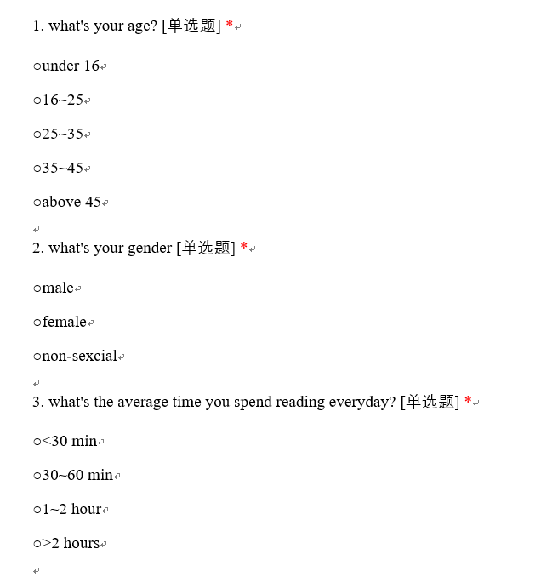
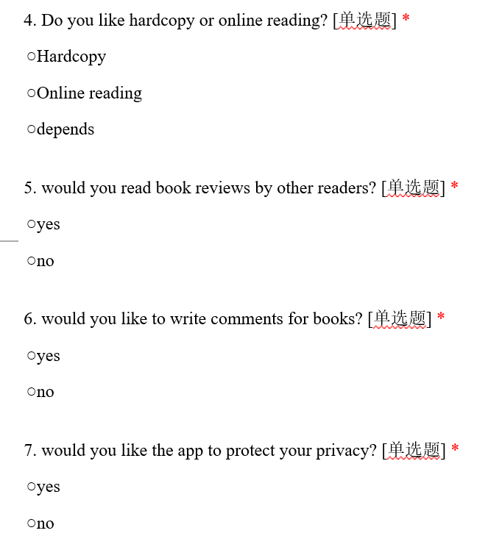
STRATEGY PLANE—USER REASERCH--SURVEY

Slide 10
STRATEGY PLANE—USER REASERCH
User requirements | Functional requirements | Technical requirements
Elegant reading experience. | Clear UI | JAVA Html css
Numerous books Recommendations for locating books | Search functions | JAVA
Reading for free | Pages algrisim | JAVA
Social functions | Extrnal links | JAVA
Writing reviews | Writing functions | JAVA
Prptecting personal data | Privacy protection | JAVA

Slide 11



STRATEGY PLANE-- PERSONA
RICHAEL
"I NEED QUICK, CLEAR ANSWERS"
RICHAEL IS INTERSTED IN LEARNING HOW SHE CAN TURN HER HOBBY OF COMBINE INTERDISAPLINE KNOWLEDGE INTO A BUSINESS.
AGE:24 FAMILY: MARRIED
OCCUPATION: COFFEE MAKER
TECHNICAL PROFILE:Macbook,iphone8,30-35 hours/week online
INTERNET USE: 40%laptop 60%mobile, reading, shopping
FAVOURITE APP:

Slide 12
Structure Plane
Conceptual Models
Error handling
Information Architecture
2
structure plane

Slide 13
Ebrary App
Search Bar
Slide up down/ page left right
Free reading for limited time
Infos in "reading life"
Charge account for books or better experience
CONCEPTUAL MODELS
Book Store
Locate wanted books
Hardcopies
Read the book in store
Recommendations from table
Buy the books

Slide 14
STRUCTUE PLANE—ERROR HANDLING
Ebrary app would automatically quit and restart as a serious mistake occurs
An unvisable pages recorded function is embedded in Ebrary to prevent accidental crash cases.
1
2
3
4
Confirmation message would come up on the screen before action when user clicks to pay for a book or top user account
Reloading button for mistake cases.

Slide 15
STRUCTUE PLANE—INFORMATION ARCHITECTURE

Slide 16
STRUCTUE PLANE—INFORMATION ARCHITECTURE

Slide 17
Scope Plane
Flow charts
User case
End-To-End flow
3
scope plane

Slide 18
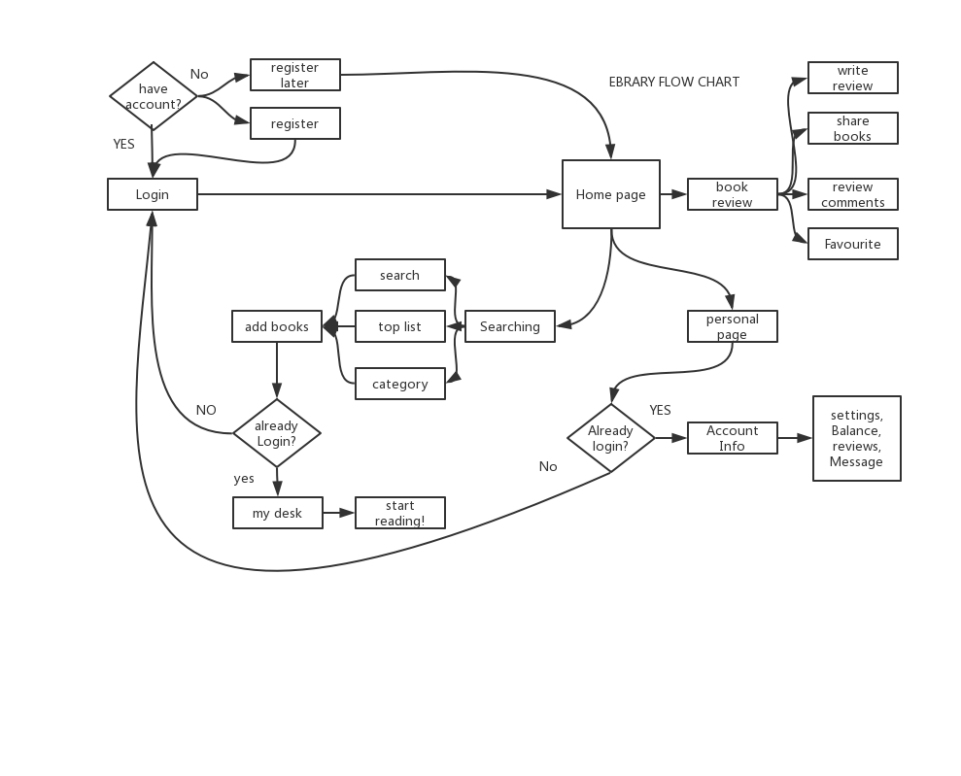
SCOPE PLANE—FLOW CHART

Slide 19
SCOPE PLANE—End-to-end FLOW
User exist ?
Email/ phone Login
Password input
User name, password correct?
Log in
Home page
Password reset
Email / phone reset
Register
Home page
External Login
Home page
Terms and conditions

Slide 20
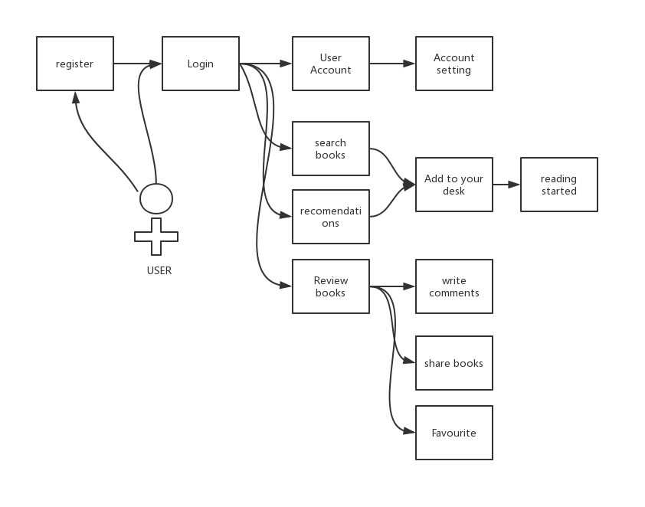
SCOPE PLANE—USER CASE

Slide 21
FLAWS
IMPROVEMENTS
MOONSHOTS
4

Slide 22
FLAWS
The reading guide does not have classification function of those guider. For example, how people know that who is the leader of psychology.
Though there is a social function for users to communicate and share their comments of books, there are not many users actually use this function. If user cannot get feedback from their comments, they may give up to output comments.
1
2
The app lacks interesting dimensions to please users
3

Slide 23
IMPROVEMRNTS
80
60
70
90
Using some rewards to motivate users use social functions
Adding a function in choiceness to classify guiders and recomendations.
Increasing more different layouts and reading styles of reading page
Making some interesting psychological test or games to help users find out their preference of books and reading styles.

Slide 24

Log in by mobile system like finger print, Voice ID or Face ID.
MOONSHOTS

Slide 25


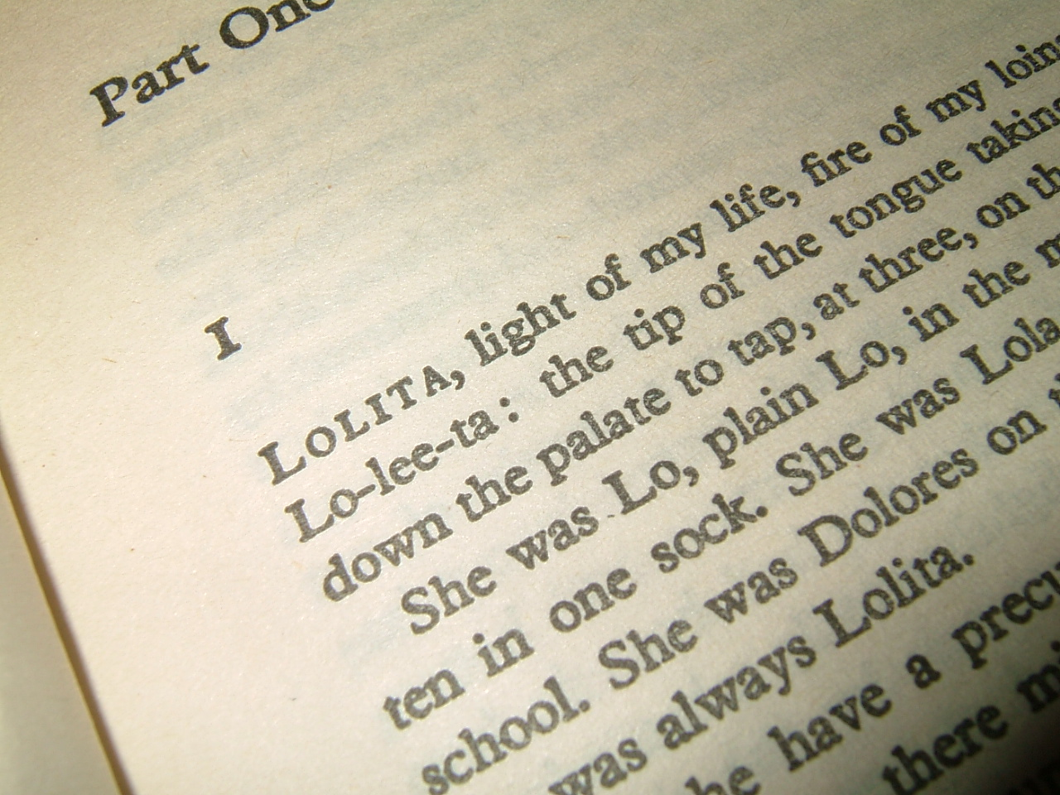
Provide intelligent way to search for books like scanning code, partial contents in books, photo of books.
MOONSHOTS

Slide 26

TEAM WORK
JUNYU LIU
Strategy Plane-User Needs
Wireframe-Desk Bar
Strategy Plane-Product Objectives
Wireframe-ReadingLife Bar
HANBAI ZHAO
ZHAOJIE LIU
Structure Plane
Wireframe-Account Bar
Wireframe-Genre Bar
Scope Plane Flow Chart
Use case & End to End FlowChart
Survey-Design
ZEFAN FENG
YING LU
Flaws, improvements and Moonshot
Wireframe-Login Bar

Slide 27
THANK YOU!
GROUP4
JUNYU LIU
YING LU
ZHAOJIE LIU
HANBAI ZHAO
ZEFAN FENG
strategy plane

